Slide 1

The Intersection of
Technology and Confidentiality:
Did That Gmail Just Blow Privilege?
CLE Presented to the Martin County Bar Association
October 2, 2026
Gerard E. Reinhardt, Principal, Reinhardt IP, PA
Copyright 2026. All rights reserved.

Slide 2
Gerard E. Reinhardt - Bio
Over 25 Years of Legal Experience:
  Complex patent litigation (Morgan & Finnegan – NYC)
  In-house pharmaceutical patent counsel (Merck, Schering-Plough)
  Broad palette of IP experience with Reinhardt IP
Areas of Expertise:
  Intellectual Property (Patents, Trademarks, Copyrights, Trade Secrets)
  Technology law
  Commercial Transactions
Licensed in Florida, New York, Texas, and the District of Columbia
Registered by the US Patent and Trademark Office as a Patent Attorney
BS and MS degrees in Chemical Engineering, (UVa, Georgia Tech), MBA (USF), JD (U of Houston)
15 years of engineering experience prior to law (Raytheon, Pratt & Whitney)

Slide 3
Disclaimer
Because many of the issues raised in this presentation have not yet been directly decided in courts of law, some of the statements herein should be recognized as being forward-looking or speculative.
Nothing in this paper shall constitute legal advice, and the presentation of this slide deck does not establish an attorney-client relationship. Consult competent counsel in case of questions.
Notes:
You are free to study the disclaimer at your leisure.

Slide 4
Agenda
Technology Backgrounder
Relevant Law and Ethics Rules
Three Recent Tech Cases
Pending Legal Questions
Suggestions
Notes:
I will start with some background materials, then move on to the two Fog Banks in this space. I will then offer some suggestions on how to deal with the challenges outlined. Questions will be taken thereafter.

Slide 5
How Would You React to Any of the Following?
A complaint containing your client’s proprietary (and somewhat shady) business plan in a document that had been uploaded to an AI platform from a device registered to your firm
The grant of a summary judgment motion adverse to your client based on metadata of a document you had produced
The evidentiary admission of an incriminating Gmail exchange between your client and yourself
A complaint based on your recording of a meeting without the consent of all parties attending
The release of confidential client information as a consequence of the hacking of your firm’s servers
A notice from the Florida Bar or a malpractice claim re any of the above

Slide 6
I. Tech Backgrounder: The Future Is in Today’s Headlines
“Latham & Watkins Buys Nvidia Servers to Set Up
In-House AI Systems”
– Financial Times, September 10, 2026.
“As A.I. Makes Law Firms More Efficient, Clients Ask: ‘Where’s My Discount?’”
- New York Times, September 26, 2026.

Slide 7
Tech Is Invasive and Pervasive
Smart phones
Online retail (Amazon, Expedia, Uber, Dynamic/personal pricing)
Online search (Google)
Online meetings (Zoom)
Harvested email (Gmail, Yahoo)
“Public” and Agentic AI (Muse)
Home entertainment (Smart TVs, Roku, Netflix)
Public surveillance (Flock LPRs, drones)
Ambient recorders (Smart phones, Siri)
Notetakers (Zoom)
Air Tags
Fintech: payment systems (Zelle), credit monitoring (Credit Karma), crypto blockchain
Biometrics: facial recognition, fingerprints

Slide 8
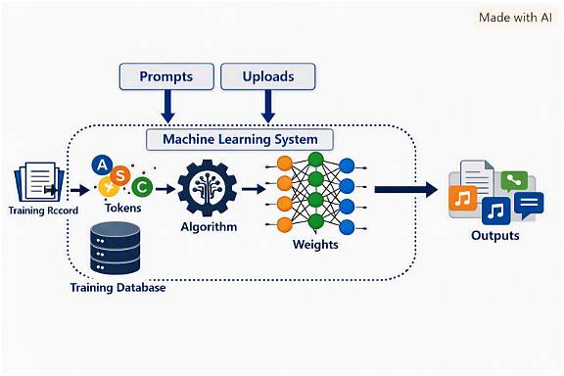
Schematic of a Typical ML System

Slide 9
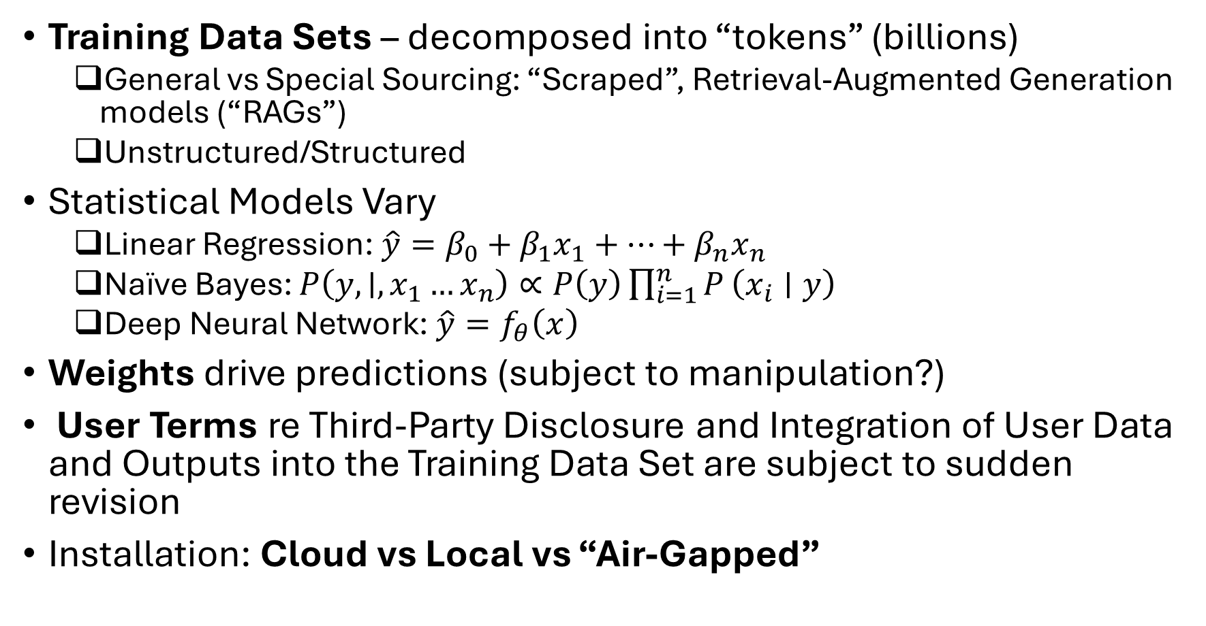
AI Is Predictive, Not Deterministic
Training Data Sets – decomposed into “tokens” (billions)
  General vs Special Sourcing: “Scraped”, Retrieval-Augmented Generation models (“RAGs”)
  Unstructured/Structured
Statistical Models Vary
  Linear Regression: $\hat{y}=β_{0}+β_{1}x_{1}+⋯+β_{n}x_{n}$
  Naïve Bayes: $P\left(y , ∣ , x_{1}…x_{n}\right)∝P\left(y\right)\prod_{i=1}^{n}{P}\left(x_{i}∣y\right)$
  Deep Neural Network:$\hat{y}=f_{θ}\left(x\right)$
Weights drive predictions (subject to manipulation?)
User Terms re Third-Party Disclosure and Integration of User Data and Outputs into the Training Data Set are subject to sudden revision
Installation: Cloud vs Local vs “Air-Gapped”

Slide 10
Google Monetizes User Information
Gmail content (but no longer for ad targeting) & metadata (sender, recipient, timestamps)
Behavioral data: searches, clicks, interactions with content and ads
Cross‑service activity: YouTube, Maps, Chrome, Android
Device identifiers
Location data
Advertising signals & purchase activity
People you communicate or share with, activity on third‑party sites/apps using Google services
Chrome browsing history (if synced)
  See Google Privacy Policy Dated May 26, 2026.

Slide 11
Claude Embeds User Information into Its
Training Database
Identity & Contacts: name, email, phone
Inputs & Outputs: prompts, uploads, outputs
Verification Data: ID images, facial geometry
Device Information: IP-derived location
Usage Information: access information, browsing & click history
Cookies: tracking, personalization
Training Data: public web, commercial data sets, user content (unless opted out),
Payment information: credit card, billing information
  See Anthropic Privacy Policy Effective July 8, 2026.

Slide 12
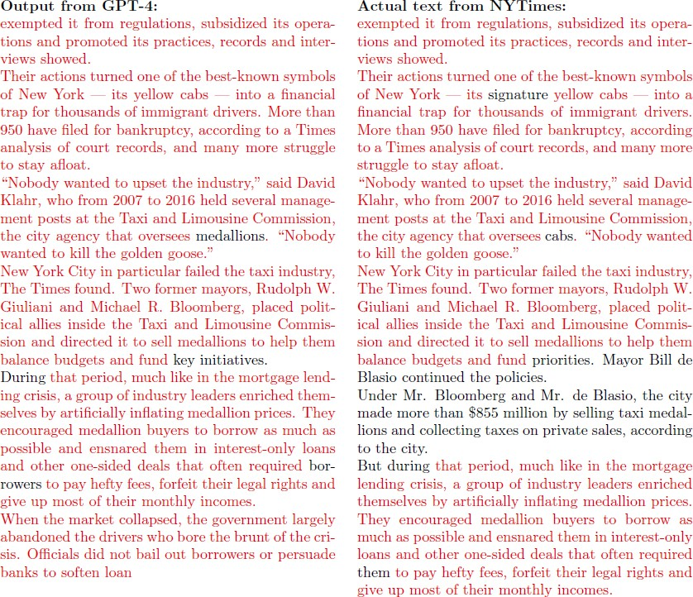
Content from the Training Database Is Available to
Any Third Party User: NYT v Open AI Complaint, p. 30.

Slide 13
II. Relevant Law and Ethics Rules:
Privilege in Florida
A communication between lawyer and client is “confidential” if it is not intended to be disclosed to third persons other than:
  1. Those to whom disclosure is in furtherance of the rendition of legal services to the client.
  2. Those reasonably necessary for the transmission of the communication.
    Fla. Stat. § 90.502 (1)(c).
A person who has a privilege against the disclosure of a confidential matter or communication waives the privilege if the person…
[1] voluntarily discloses or
[2] makes the communication when he or she does not have a reasonable expectation of privacy, or
[3] consents to disclosure of, any significant part of the matter or communication…
  Fla. Stat. § 90.507.

Slide 14
FL Ethics Rules that May Involve Tech
Confidentiality
(a) Consent Required to Reveal Information.
  A lawyer must not reveal information relating to the representation of a client… unless the client gives informed consent.
(e) Duty to Prevent Disclosure
  A lawyer must make reasonable efforts to prevent the inadvertent or unauthorized disclosure of, or unauthorized access to, information relating to the representation of a client.
  Rules Regulating the Florida Bar r. 4‑1.6 (2024).
Notes:
Now we come to Fog Bank No. 2: Inventorship

Slide 15
The Duty of Competence
A lawyer shall provide competent representation to a client. Competent representation requires the legal knowledge, skill, thoroughness, and preparation reasonably necessary for the representation.
  Florida Rule 4-1.1.
To maintain the requisite knowledge and skill, a lawyer should keep abreast of changes in the law and its practice, engage in continuing study and education, including an understanding of the benefits and risks associated with the use of technology, including generative artificial intelligence…
[A] lawyer should be aware that generative artificial intelligence may create risks to the lawyer's duty of confidentiality.
  In re Amendments to Rules Regulating the Fla. Bar, 393 So. 3d 137, 139 (Fla. 2024).

Slide 16
Duty of Diligence
A lawyer shall act with reasonable diligence and promptness in representing a client.
  Florida Rule 4-1.3.
A lawyer should pursue a matter on behalf of a client… and take whatever lawful and ethical measures are required to vindicate a client’s cause or endeavor.
  Florida Rule 4-1.3 cmt. (2024).

Slide 17
Tech is a Tool, Not a Nonlawyer Assistant
Lawyers must supervise nonlawyer assistants and ensure their conduct is compatible with professional obligations.
  Rule 4‑5.3.
A lawyer should also consider safeguards when assistants use technologies such as generative artificial intelligence.
  In re Amendments to Rules Regulating the Fla. Bar, 393 So. 3d 137, 146 (2024).

Slide 18
Will the Widespread Adoption of Tech
Lower the Threshold of “Clearly Excessive” Fees?
Fees and Costs for Legal Services
A lawyer must not enter into an agreement for, charge, or collect an illegal, prohibited, or clearly excessive fee or cost…
  Rule 4-1.5.

Slide 19
Privacy – Federal
“The right of the people to be secure in their persons, houses, papers, and effects, against unreasonable searches and seizures, shall not be violated, and no Warrants shall issue, but upon probable cause, supported by Oath or affirmation, and particularly describing the place to be searched, and the persons or things to be seized.”
  USCS Const. Amend. 4.
Notes:
Then, along comes computer scientist and AI champion Dr. Stephen Thaler, who files a patent application naming as the sole inventor his AI model Device for Bootstrapping of Unified Science (“DABUS”). The court approached this case as an exercise in the interpretation of unambiguous statutory language.

Slide 20
Privacy in Florida
The right of the people to be secure in their persons, houses, papers and effects against unreasonable searches and seizures, and against the unreasonable interception of private communications by any means, shall not be violated…
This right shall be construed in conformity with the 4th Amendment to the United States Constitution, as interpreted by the United States Supreme Court.
  Fla. Const. Art. I, § 12.

Slide 21
The FL Right to Right to Be Let Alone
Every natural person has the right to be let alone and free from governmental intrusion into the person’s private life…
Fla Const. Art. I, §23.
[T]he right to privacy in the Florida Constitution is broader, more fundamental, and more highly guarded than any federal counterpart…
  Weaver v. Myers, 229 So. 3d 1118, 1125, 2017 (FL Sup. Ct. 2017).

Slide 22
Consent of All Parties to a Communication in FL
It is lawful… for a person to intercept a wire, oral, or electronic communication when all of the parties to the communication have given prior consent to such interception.
  Fla. Stat. §934.03(2)(d).
Absent the prior consent of all parties, recording an oral communication constitutes an unlawful interception...
  State v. Walls, 356 So. 2d 294 (1978).
.

Slide 23
Florida Trade Secrets
“Trade secret” means information, including a formula, pattern, compilation, program, device, method, technique, or process that:
(a) Derives independent economic value, actual or potential, from not being generally known to, and not being readily ascertainable by proper means by, other persons who can obtain economic value from its disclosure or use; and
(b) Is the subject of efforts that are reasonable under the circumstances to maintain its secrecy.
Fla. Stat. §688.002.
Reasonable measures to keep digital content secret can include inter alia:
Access control policies or measures, e.g., managed passwords, thumbprints, or iris scans;
Data encryption
VPNs
Multi-Factor Authentication
Robust firewalls
Disclosing the information to others who are under no obligation to protect the confidentiality of the information defeats any claim that the information is a trade secret.
  M.C. Dean, Inc. v. City of Miami Beach, 199 F. Supp. 3d 1349, 1353 (S.D. FL, 2016).

Slide 24
III. Cases Involving Tech:
Katz v US - The Genesis of the
Reasonable Expectation of Privacy
Majority: Attachment of a listening device to the exterior of a phone booth and then recording a person’s telephone conversation was held to be a “search and seizure” under the Fourth Amendment, requiring a warrant.
“What a person knowingly exposes to the public, even in his own home or office, is not a subject of Fourth Amendment protection.”
Concurrence of J. Harlan: [A]n enclosed telephone booth is an area where, like a home, and unlike a field, a person has a constitutionally protected reasonable expectation of privacy…
[T]here is a twofold requirement,
first that a person have exhibited an actual (subjective) expectation of privacy and,
second, that the expectation be one that society is prepared to recognize as "reasonable."
See Katz v. United States, 389 U.S. 347 (1967).

Slide 25
Online Searches
A reverse keyword search is not a search under the 4th Amendment in Pennsylvania
D lacked an expectation of privacy in the material he voluntarily shared while conducting a Google search in view of the third-party disclosures referenced in the Google Privacy Policy.
  Commonwealth v. Kurtz, 98 MAP 2023, 99 MAP 2023 & 100 MAP 2023, J‑36A‑2024, J‑36B‑2024 & J‑36C‑2024 (Pa. Dec. 16, 2025).
In Florida, law enforcement must generally obtain a warrant to require an electronic communication service provider to disclose the contents of electronic communications stored for 180 days or less.
See Fla. Stat. §934.23.

Slide 26
Privilege in AI Output
In a criminal matter, documents prepared by D’s use of Claude (without the knowledge of counsel), then transmitted to counsel were not privileged for three reasons:
1) Claude is not an attorney, so the documents are not communications between D and his counsel.
2) The communications memorialized in the documents were not confidential… [because] D communicated with a third-party AI platform… [and] the written privacy policy to which users of Claude consent provides that Anthropic collects data on both users’ "inputs" and Claude's 'outputs”…
3) D did not communicate with Claude for the purpose of obtaining legal advice since Claude disclaims providing legal advice.
  See United States v. Heppner, 820 F. Supp. 3d 292 (S.D.N.Y. 2026)

Slide 27
But, Work Product Protection Has Been Found in AI Output Prompted by a Pro Se Civil Litigant
A pro se litigant’s use of AI in litigation preparation is entitled to work product protection under Federal Rule of Civil Procedure 26(b)(3).
Distinguished from Heppner in two ways:
1) Heppner was a criminal matter, whereas Morgan is a civil case governed by Rule 26(b)(3), which broadly protects the work product of a party, not merely counsel
2) Unlike Heppner, where the defendant acted entirely apart from his lawyer, no party-attorney gap exists in the pro se context, where the litigant is both the party and the advocate.
◊ Inputting information into a publicly available AI tool does not automatically waive work product protection, citing Carpenter v. United States, 585 U.S. 296 (2018).
See Morgan v. V2X, Inc., No. 25-cv-01991 (D. Colo. Mar. 30, 2026).

Slide 28
Cell Phone Location Data (“Geofencing”) –
The Demise of the Third Party Doctrine?
A cell phone user has a reasonable expectation of privacy in Cell Site Location Information (“CSLI”) automatically collected by a third party.
The third-party doctrine does not apply due to:
1) the scope and revelatory nature of CSLI; and,
2) the lack of effective consent based on the indispensable nature of cell phones to participation in modern society.
“[A] warrant is required only in the rare case where the suspect has a legitimate privacy interest in records held by a third party.”
See Carpenter v. United States, 585 U.S. 296 (2018).
An individual has a reasonable expectation of privacy in his cell-phone Location History even after the user had opted-in to collection of the data by a third party.
See) Chatrie v. United States, 146 S. Ct. 2193, 2196 (June 29, 2026.
Notes:
The USPTO then continued with its implications of the unspeakable.

Slide 29
IV. Some Legal Questions to Ponder
1. Is a contractual right of third-party disclosure a third party disclosure?
  Re: a) Privilege
  b) Privacy
2. Is a contractual right to third-Party Disclosure a Publication?
  Re: a) Defamation
  b) Patent prior art
  c) Trade secret destruction
  d) Copyright damages reduction
3. What other types of information will trigger exemption from third-party doctrine vis à vis Carpenter?
  Histories re online browsing, purchase, travel, financial
4. To what other rights might consent to waiver be ineffective?

Slide 30
V. Diligently Manage Tech Risks & Find Counterparty Lapses
Use and caution clients to use only:
  Non-harvested, VPN, encrypted messaging and email platforms (Signal, Proton)
  Secure online search platforms (Startpage, Brave Search, Duckduckgo)
  Legal/Enterprise AI (Protégé/Claude for Enterprise)
Consider deploying local “air-gapped” AI (ONES.com)
Scrub your metadata (Foxit, Doc Scrubber) and check for counterparty’s metadata (Metadata2Go)
Update cybersecurity policies and conduct cybersecurity audit
Discover and demand production of harvested emails
Discover and prompt consumer-grade AI platforms (using agentic AI?)

Slide 31

How Will You Respond to the
Rapidly Changing Intersection of Technology & Law?

Slide 32

I Thank You for Your Attention
Intellectual Property Services:
(Patents, Trademarks, Copyrights, Trade Secrets)
  Acquisition
  Monetization: development, licensing
  Enforcement and defense
  Due diligence in M&A
  Subject matter includes engineering, technology, & life sciences
Commercial transactions, entity formation
Technology law, including Artificial Intelligence
Licensed in Florida, New York, Texas, and the District of Colombia
Patent Attorney registered by the U.S. Patent & Trademark Office (Reg. No. 43,041)
Gerard@ReinhardtIP.com ph: 516-672-3988 ReinhardtIP.com

